Slide 1
Types of API
REST API Consumers

Slide 2



3 Types of REST API 1. Private/Internal 2. Public or External 3. Partner
REST API Consumer
Notes:
----- CLICK
----- Private / Internal API – Consumers of API are internal within the company or organization
----- Public / External --- API is placed outside of the company or organization for consumption
----- Partner ----- this consumer has a trusted relationship with the enterprise organization or company that is creating or exposing the API, so this implementation is based on
---- there are these 3 type of consumers and 3 types of APIs

Slide 3

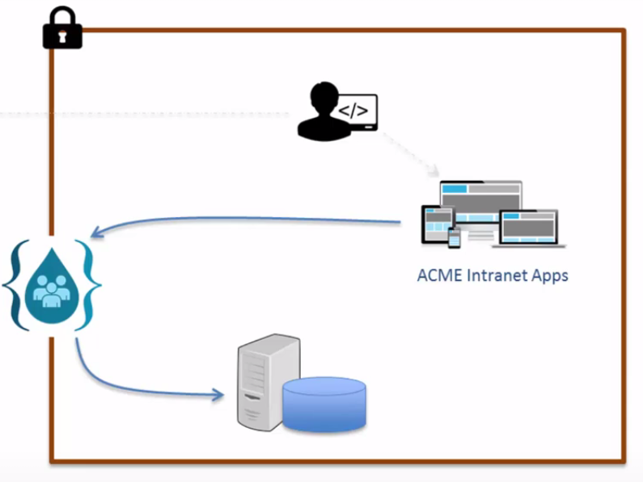
Mixed Interfaced API Public/Private
Notes:
--- The application that use a public or private API interface could either be inside the enterprise, which makes access to the application private (CLICK)
--- Also notice that the API is sitting at the edge of the enterprise network, this allows public applications to get access to the representational state that are contained in the private database

Slide 4

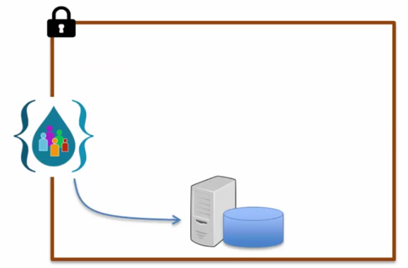
Public API Interface
Notes:
------ The public API is always on the edge of the Enterprise to provide a control access to the enterprise resources
---- (CLICK) The public developer is an untrusted developer who creates applications (CLICK) which connect to the enterprise resources by way of this public API

Slide 5


Private API Interface
Notes:
------ The private API is always consumed by the enterprise developers within the same enterprise organization
---- (CLICK) These application maybe internal to the application (CLICK) and they may use the external interfacing API or they may be application from outside the enterprise
------ in which case (CLICK) they would use the same API

Slide 6
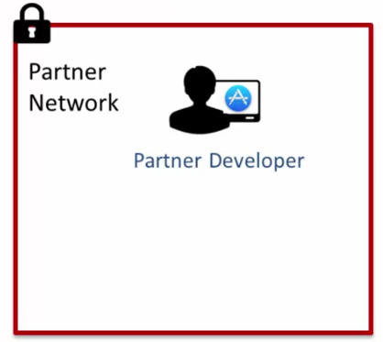
Partner API Interface
Notes:
------ In the case of partner organization exposes API to trusted partners and the trusted partner developers (CLICK) can create applications(CLICK) which operates within the content of the partner network and access the partner’s API
------- while at the same time the partner developer can be developing applications which may be available to the open market (CLICK) (CLICK)
------- and these application (CLICK) can interface with the exposed API of the partner (CLICK)
---------- in this scenario this is very similar to a public API however, in this case a public developer is not involved the developer is a partner developer
-------- so the organization who is exposing the API is aware of who is connecting to their enterprise resources

Slide 7




API Considerations
Notes:
---- There is little difference in the coding or designing of the 3 types of REST APIs
---- the difference is in how you manage the 3 types of APIs
---- AS the API developer there are 4 aspects which have to be considered and think through when designing and developing an API
++++ The API Security, the documentation of the API, Access Request of the API and the SLA Management of the API
---- API Security -

Slide 8



API Security
Notes:
---- in the case of API Security, the clients access the API are known, these are the APP developers who are called (CLICK) Trusted Developers
---- in this case you really don’t need forms of strict security (CLICK) you can use Basic Authentication or some token based proprietary schemes

Slide 9




API Security
Notes:
----- With a Partner API (CLICK) or Public API, (CLICK) you cannot trust (CLICK) the Developers or the API consumers
----- in this case you have to use a stricter form of security such as (CLICK) key/secret or OAuth
----- the developer should adopt a standard security sheme such as Key/Secret or Oauth for all your API

Slide 10






API Documentation
Notes:
------ Developers need the API documentation to code against it
For Example: in the case of the Private API (CLICK) or Partner API we are referring to a (CLICK) Controlled Environment
---- The API provider knows the API consumers so the documentation can be provided by way of (CLICK) email, PDF or some type of Internal Website
---- in the case of a public API Interface, (CLICK) this type of interface is called an uncontrolled environment
----- Now you don’t know who the consumer of the API is

Slide 11




Access Request
Notes:
-------- once the API is ready in order for the API application developer or consumer to use the API, they need to send a request to the API to get the information from the API
------- (CLICK) for the private or internal API, this internal process can be an ad hoc process, it can be by way of an (CLICK) email or internal ticketing / process
------ (CLICK) in the case of a public API, we are talking about an uncontrolled environment where a web site is created and the app developer can raise a request to get access to the API by using this website

Slide 12

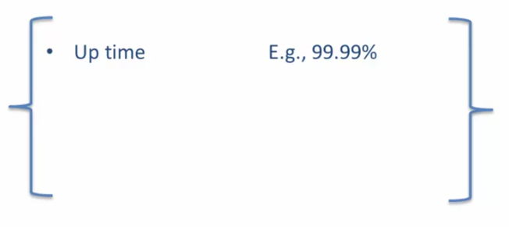


SLA Management
Notes:
--- An example of the SLA Agreement (CLICK) is when the API provider guarantee an up time of 99% for the API (CLICK)
----- A maximum Through put of 20 Calls/Second without performance degradation
----- and Support Via Email
------- (CLICK) it is typical to have different SLA Tiers for different developers, example internal developers can get unlimited web access to the API contrary to external developers having limited access to the API
------ (CLICK) Another important consideration is the Runtime Management and monitoring of the API, this can be done by watching the key performing indicators to assure that the provider of the API is offering a quality of service for the consumer of the API

Slide 13



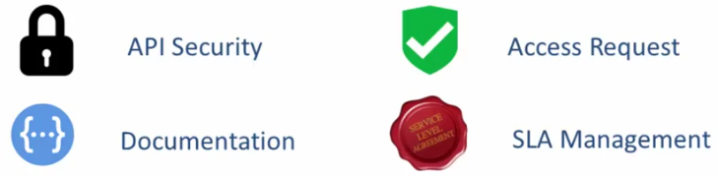
Summary
Notes:
--- (CLICK) we discussed the Private API
---- (CLICK) the public API
------ (CLICK) and the Partner API
---- the private API are the ones that leverage security and are exposed mainly to trusted developers
------- the public API are the ones that are exposed to the public and untrusted developers, the consumer of the API are not known to the API developers or organization
------- the API consumer is know but cannot be trusted
------ all of these APIs are designed and coded the same way (CLICK)
------ the difference is in how you mange the 3 Types of API, Management of the API comes in the form of API Security, Documentation, Access Request, SLA Management

